Slide 1
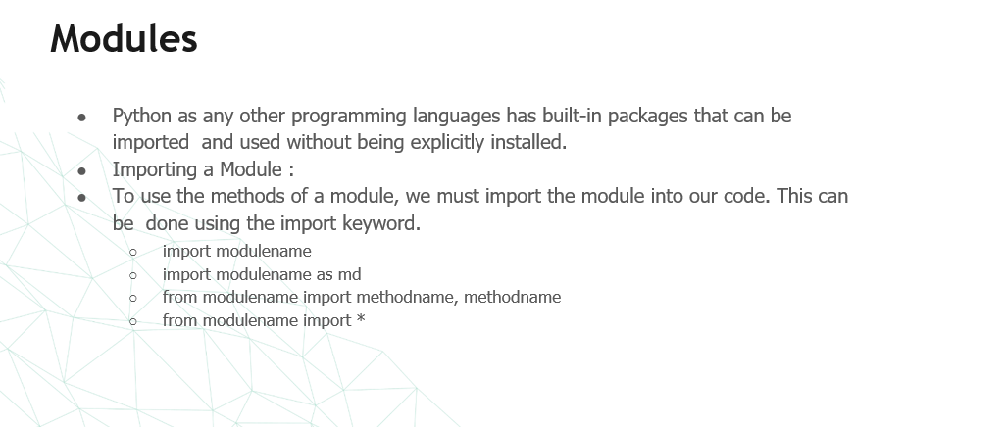

Slide 2
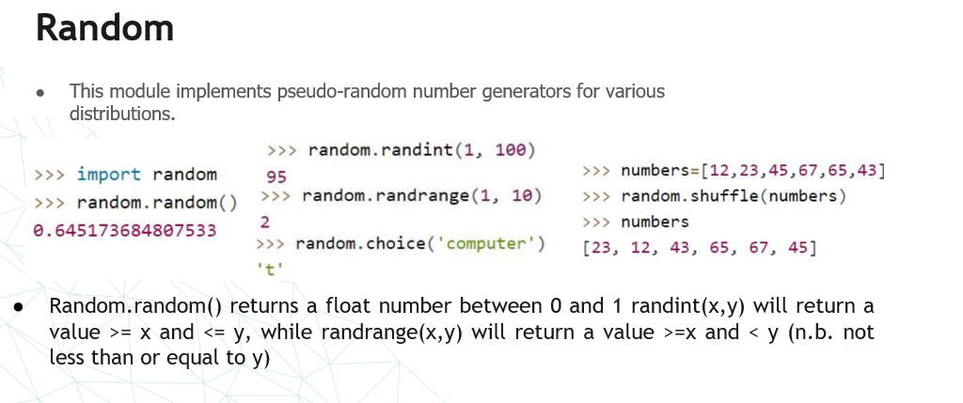

Slide 3
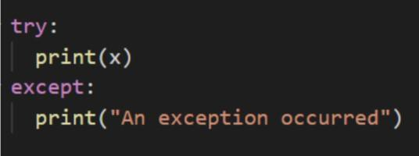
Try, Except
Python has many built-in exceptions that are raised when your program encounters an error
(something in the program goes wrong)
built-in exceptions
IOError , ValueError , ImportError , EOFError , KeyboadInterrupt ,ZeroDivisionError…
Link to Error Handling

Slide 4
API

Slide 5
What is an API?
API stands for Application Programming Interface.
It allows different software applications to communicate and share data.
Works like a translator between two systems, enabling them to work together.

Slide 6
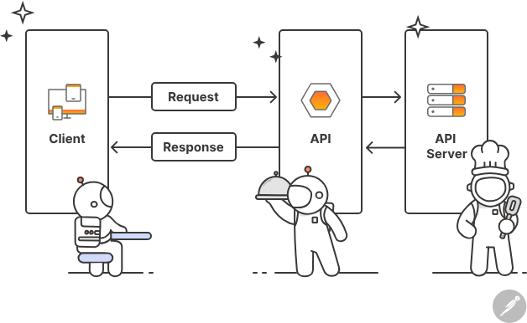

Slide 7
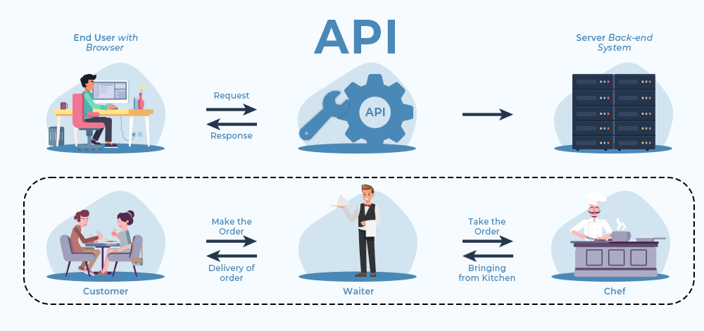

Slide 8
How APIs Work: Request-Response Cycle
API Client:
The application sending a request.
Example: A mobile app asking a server for data.
API Server:
The system that receives the request and processes it.
Example: A database or web server that holds the requested information.

Slide 9
API Request Components
Endpoint: The URL where the API can be accessed (e.g., /users).
Method: The type of request (e.g., GET, POST, PUT, DELETE).
Parameters:
Information passed to the API,
In the URL or the request body.
Or in Body: Data sent with the request (only for POST and PUT methods).
Headers: Extra information like authentication or content type.

Slide 10
API Response Components
Status Code:
Indicates the result of the request (e.g., 200 OK, 404 Not Found).
Headers:
Additional information like content type.
Response Body:
The actual data returned by the API or an error message.
https://developer.mozilla.org/en-US/docs/Web/HTTP/Status#redirection_messages

Slide 11
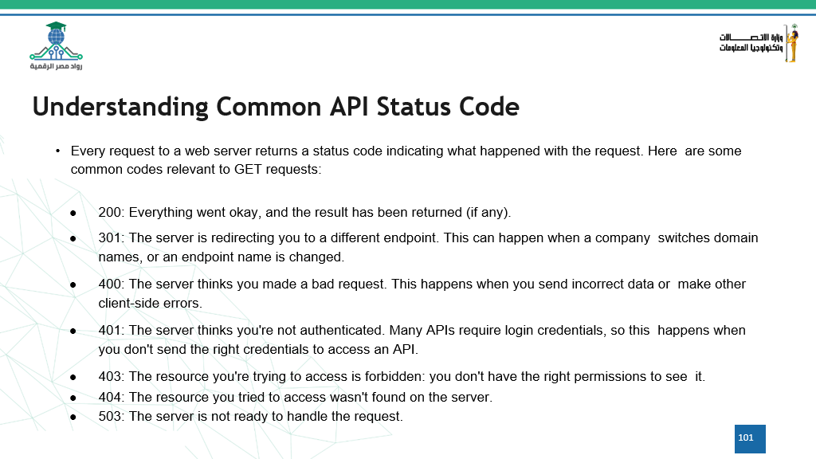

Slide 12
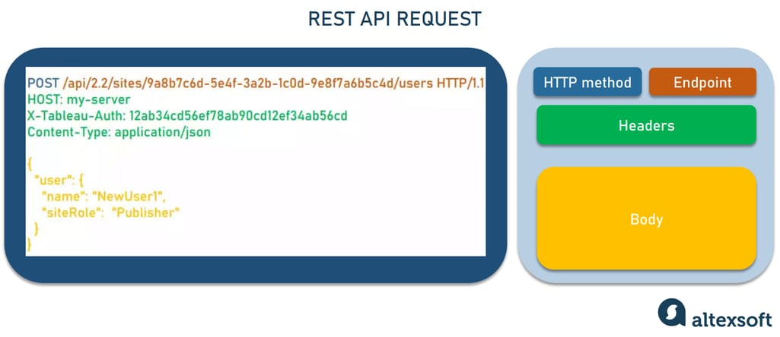

Slide 13
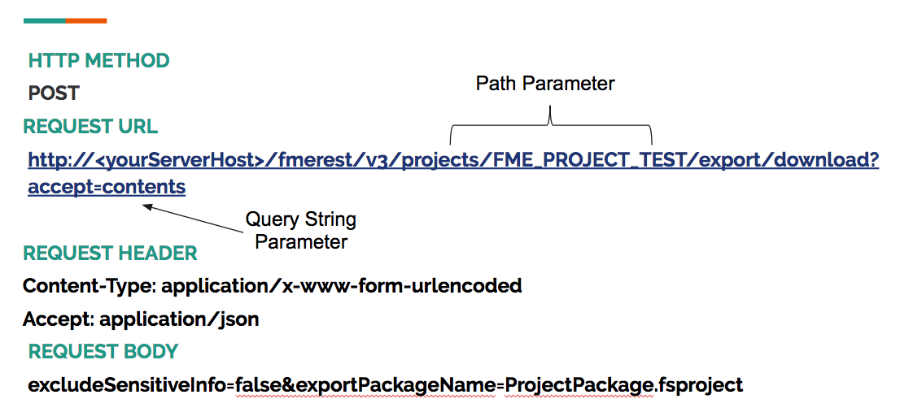

Slide 14
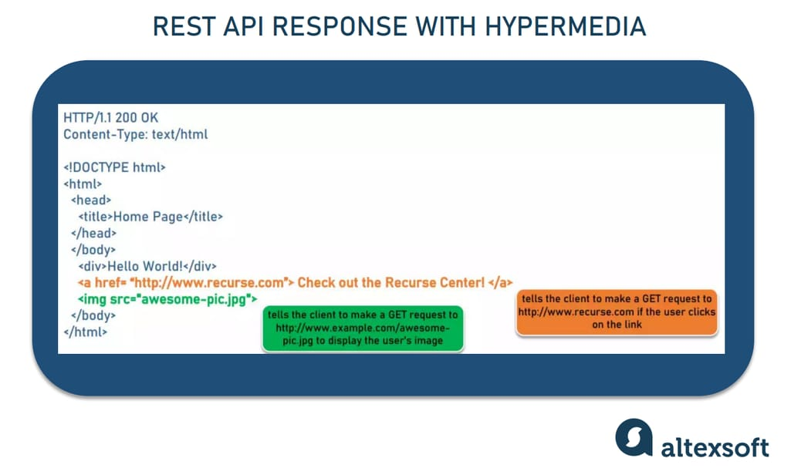

Slide 15
Example of API in Action
User searches for a product in an e-commerce app.
The API Client (app) sends a GET request to the server.
The API Server returns product details as a Response.
The Client displays the results to the user.

Slide 16
API architectural styles
REST API: A simple and widely-used design pattern for communicating over HTTP between applications using standard methods like GET and POST.
FastAPI: A modern, very fast Python framework for building APIs, offering automatic documentation and high performance.
GraphQL: A flexible query language that allows you to request exactly the data you need from a server.
gRPC: A high-performance framework by Google that uses HTTP/2 to efficiently exchange data between services.

Slide 17
API architectural styles
SOAP: An older and reliable protocol that uses XML to transfer data, ideal for sensitive systems like banking.
JSON-RPC: A lightweight protocol based on JSON for performing remote procedure calls between applications.
OData: A protocol that uses HTTP to query and manipulate data in a way similar to SQL.
OpenAPI/Swagger: A standard for documenting and designing REST APIs with an interactive interface for easier understanding and use.

Slide 18
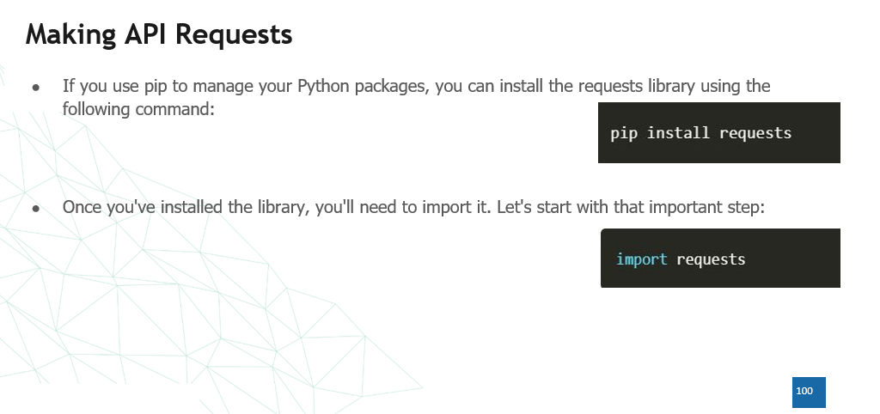

Slide 19
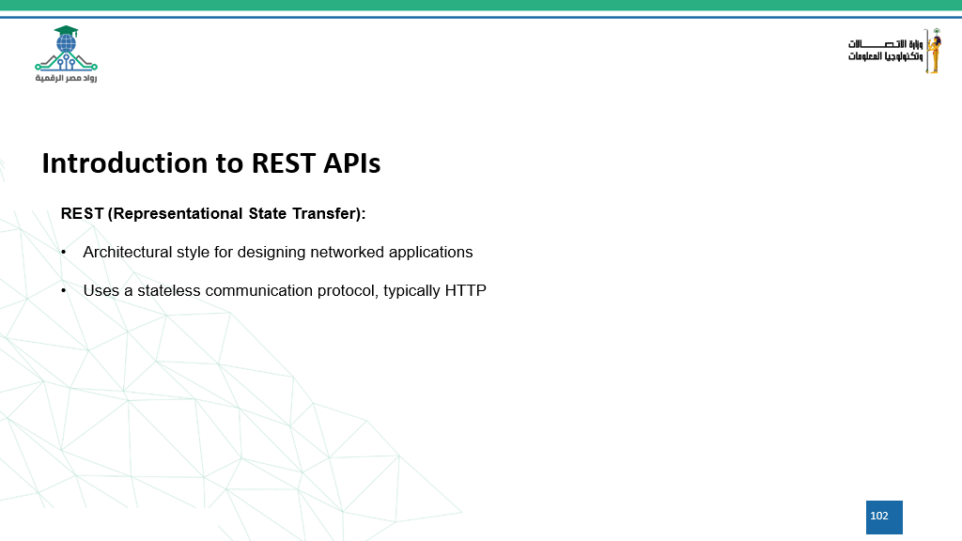

Slide 20
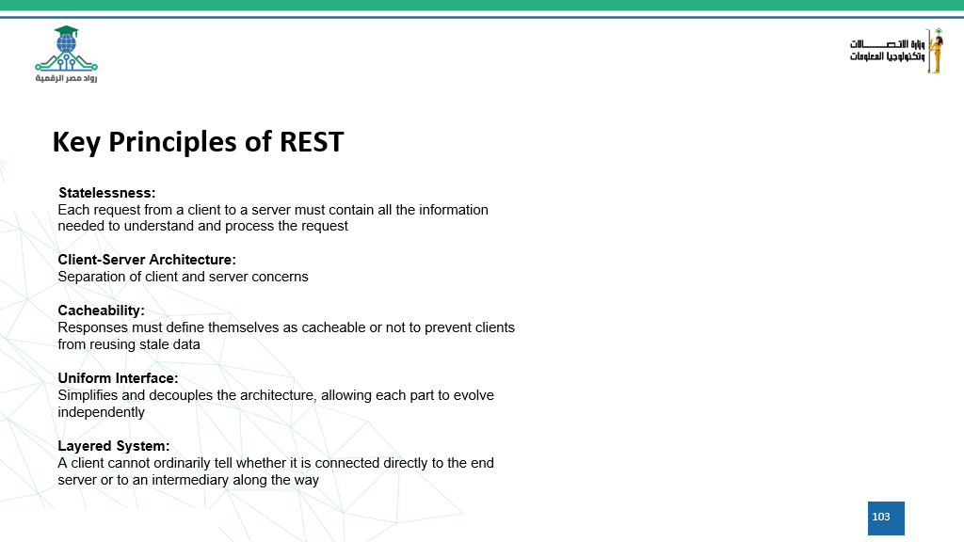

Slide 21
Files I/O

Slide 22
Files I/O
The simplest way to produce output is using the print statement where you can pass zero or more expressions separated by commas. This function converts the expressions you pass into a string and writes the result to standard output as follows:
This produces the following result on your standard screen
Print("Python is really a great language,", "isn't it?“)
Python is really a great language, isn't it?

Slide 23
Reading Keyboard Input
Python provides two built-in functions to read a line of text from standard input, which by default comes from the keyboard. These functions are
raw_input
input

Slide 24
The raw_input Function
The raw_input([prompt]) function reads one line from standard input and returns it as a string (removing the trailing newline).
This prompts you to enter any string and it would display same string on the screen. When I typed "Hello Python!", its output is like this
str = raw_input("Enter your input: "); print "Received input is : ", str
Enter your input: Hello Python Received input is : Hello Python

Slide 25
The input Function
The input([prompt]) function is equivalent to raw_input, except that it assumes the input is a valid Python expression and returns the evaluated result to you.
This would produce the following result against the entered input
str = input("Enter your input: "); print("Received input is : ", str)
Enter your input: [x*5 for x in range(2,10,2)] Received input is : [10, 20, 30, 40]

Slide 26
Opening and Closing Files
Until now, you have been reading and writing to the standard input and output. Now, we will see how to use actual data files.
Python provides basic functions and methods necessary to manipulate files by default. You can do most of the file manipulation using a file object.

Slide 27
The open Function
Before you can read or write a file, you have to open it using Python's builtin open() function. This function creates a file object, which would be utilized to call other support methods associated with it.
Syntax
file object = open(file_name [, access_mode][, buffering])

Slide 28
The open Function
Here are parameter details:
file_name: The file_name argument is a string value that contains the name of the file that you want to access.
access_mode: The access_mode determines the mode in which the file has to be opened, i.e., read, write, append, etc. A complete list of possible values is given below in the table. This is optional parameter and the default file access mode is read (r).

Slide 29
The open Function
buffering: If the buffering value is set to 0, no buffering takes place. If the buffering value is 1, line buffering is performed while accessing a file. If you specify the buffering value as an integer greater than 1, then buffering action is performed with the indicated buffer size. If negative, the buffer size is the system default(default behavior).

Slide 30
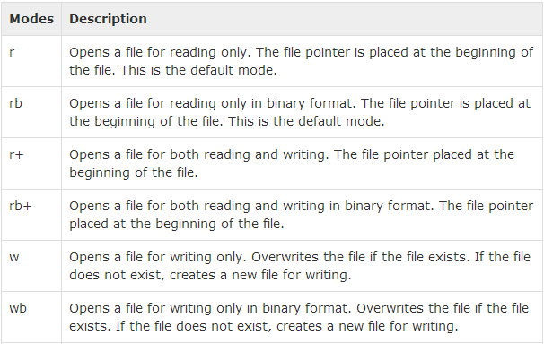
Here is a list of the different modes of opening a file:

Slide 31
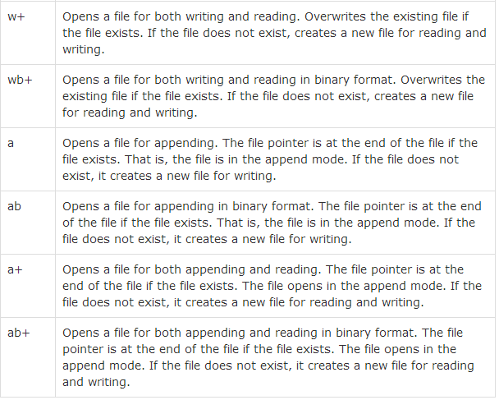

Slide 32
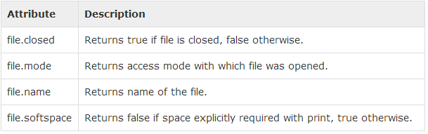
The file Object Attributes
Once a file is opened and you have one file object, you can get various information related to that file.
Here is a list of all attributes related to file object:

Slide 33
Example
# Open a file fo = open("foo.txt", "wb") print "Name of the file: ", fo.name print "Closed or not : ", fo.closed print "Opening mode : ", fo.mode print "Softspace flag : ", fo.softspace
Name of the file: foo.txt Closed or not : False Opening mode : wb Softspace flag : 0

Slide 34
The close() Method
The close() method of a file object flushes any unwritten information and closes the file object, after which no more writing can be done.
Python automatically closes a file when the reference object of a file is reassigned to another file. It is a good practice to use the close() method to close a file.
Syntax
fileObject.close();

Slide 35
Example
# Open a file fo = open("foo.txt", "wb") print "Name of the file: ", fo.name # Close opend file fo.close()
Name of the file: foo.txt

Slide 36
The write() Method
The write() method writes any string to an open file. It is important to note that Python strings can have binary data and not just text.
The write() method does not add a newline character ('\n') to the end of the string −
Syntax
Here, passed parameter is the content to be written into the opened file.
fileObject.write(string);

Slide 37
Example
# Open a file fo = open("foo.txt", "wb") fo.write( "Python is a great language.\nYeah its great!!\n"); # Close opend file fo.close()
Python is a great language. Yeah its great!!

Slide 38
The read() Method
The read() method reads a string from an open file. It is important to note that Python strings can have binary data. apart from text data.
Syntax
Here, passed parameter is the number of bytes to be read from the opened file. This method starts reading from the beginning of the file and if count is missing, then it tries to read as much as possible, maybe until the end of file.
fileObject.read([count]);

Slide 39
Example
# Open a file fo = open("foo.txt", "r+") str = fo.read(10); print "Read String is : ", str # Close opened file fo.close()
Read String is : Python is

Slide 40
Directories in Python
All files are contained within various directories, and Python has no problem handling these too.
The os module has several methods that help you create, remove, and change directories.

Slide 41
The mkdir() Method
You can use the mkdir() method of the os module to create directories in the current directory. You need to supply an argument to this method which contains the name of the directory to be created.
Syntax
#!/usr/bin/python import os # Create a directory "test" os.mkdir("test")
os.mkdir("newdir")

Slide 42
The chdir() Method
You can use the chdir() method to change the current directory. The chdir() method takes an argument, which is the name of the directory that you want to make the current directory.
Syntax
os.chdir("newdir")
import os # Changing a directory to "/home/newdir" os.chdir("/home/newdir")

Slide 43
The getcwd() Method
The getcwd() method displays the current working directory.
Syntax
os.getcwd()
import os # This would give location of the current directory os.getcwd()

Slide 44
The rmdir() Method
The rmdir() method deletes the directory, which is passed as an argument in the method.
Before removing a directory, all the contents in it should be removed.
Syntax:
os.rmdir('dirname')
import os # This would remove "/tmp/test" directory. os.rmdir( "/tmp/test" )

